Slide 1
Complex Integration (Line Integral) Exercise:6 (part-2)

Slide 2
Objective:
Finding the path of integration in different form and evaluating some line integrals for a simple path
Methodologies:
By using the path and reducing the integrands into a single valued function, line integrals will be evaluated

Slide 3

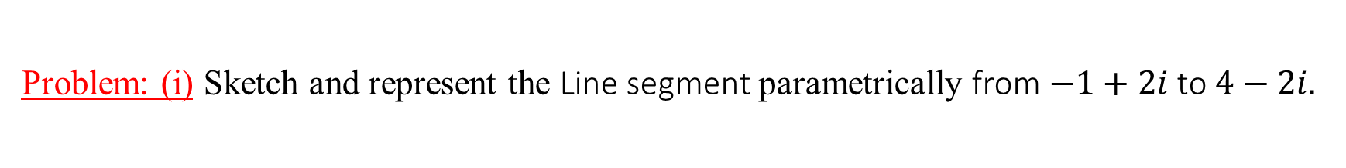


Problem: (i) Sketch and represent the Line segment parametrically from $−1+2i$ to $4−2i.$
Solution: Equation of the line from $−1+2i$ or $(−1,2)$ to $4−2i$ or $(4,−2)$ is:
$\frac{y−y_{1}}{y_{1}−y_{2}}=\frac{x−x_{1}}{x_{1}−x_{2}}$ $⇒$ $\frac{y−2}{2+2}=\frac{x+1}{−1−4}$
$⇒$ $\frac{y−2}{4}=\frac{x+1}{−5}$
$⇒y−2=−\frac{4}{5}(x+1)$
$⇒y=−\frac{4}{5}x−\frac{4}{5}+2$
$$⇒y=−\frac{4}{5}x+\frac{6}{5}$$
Let $x=t$
$∴y=−\frac{4}{5}t+$ $\frac{6}{5}$
So, $z=x+iy=t+i(−\frac{4}{5}t+\frac{6}{5})$ where $t=−1$ to $t=4$.
Which is a parametric representation of the given line segment.
Im {z}
$$(−1, 2)$$
Re{z}
O
$$(4,−2)$$

Slide 4

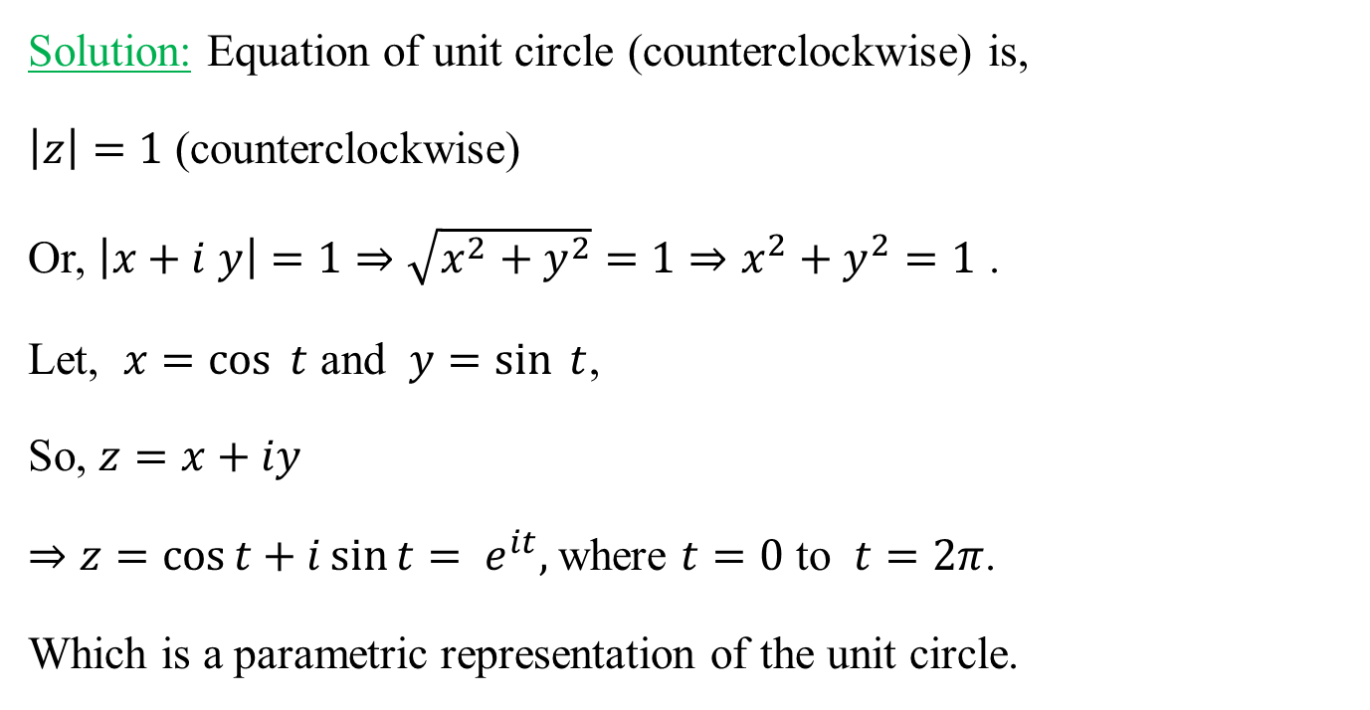
Problem: (ii) Sketch and represent unit circle (counter-clockwise) parametrically.
Solution: Equation of unit circle (counterclockwise) is,
$\left|z\right|=1$ (counterclockwise)
Or, $\left|x+i y\right|=1⇒\sqrt{x^{2}+y^{2}}=1⇒x^{2}+y^{2}=1$ .
Let, $x=\cos{t}$ and $y=\sin{t}$,
So, $z=x+iy$
$⇒z=\cos{t+i\sin{t= e^{it}, }}$where $t=0$ to $t=2π$.
Which is a parametric representation of the unit circle.
Im {z}
$$1$$
Re{z}
O

Slide 5

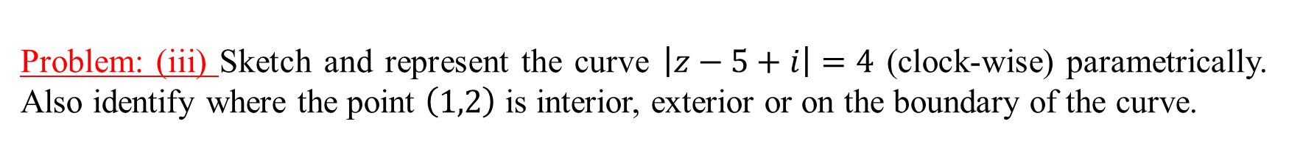



Problem: (iii) Sketch and represent the curve $\left|z−5+i\right|=4$ (clock-wise) parametrically. Also identify where the point $\left(1,2\right)$ is interior, exterior or on the boundary of the curve.
Solution: Given equation of the curve is,
$\left|z−5+i\right|=4$ (clock-wise)
$⇒\left|x+i y−5+i\right|=4$
$⇒\left|(x−5)+i (y+1)\right|=4$
$⇒\sqrt{{(x−5)}^{2}+{(y+1)}^{2}}=4$
$⇒{(x−5)}^{2}+{(y+1)}^{2}=16$ .
Let, $x−5=4 cos{t}⇒x=5+4\cos{t}$
and $y+1=4 sin{t⇒y=−1+4\sin{t}}.$
So, $z=x+iy$
$⇒z=5+4 cos{t+i(−1+sin{t) }}$
$⇒z=5−i+4e^{it}$ , where $t=2π$to $t=0$.
Which is a parametric representation of the given curve which is a circle of radius 4 and center at $\left(5,−1\right)$.
Im {z}
Or, $\left|z−5+i\right|=4$
$⇒$ $z−5+i=4e^{it}$
$⇒z=5−i+4e^{it}$
where $t=2π$to $t=0.$
O
$$(5,−1)$$
Re{z}
$$4$$

Slide 6

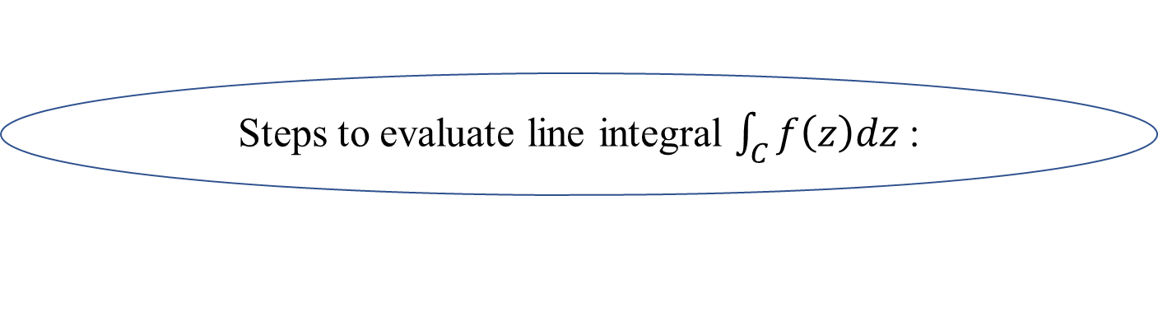
Steps to evaluate line integral $\int_{C}{f\left(z\right)dz}$:
Step 1: Find the equation of the path $C$ in cartesian or polar (for circular path) form
Step 2: Find the integrand $f(z)$ using equation of $C$
Step 3: Find $dz$ from $z=x+iy$ or $z=re^{iθ}\left( for circular path\right)$
Step 4: Evaluate the line integral $\int_{C}{f\left(z\right)dz}$ using the information from step 1, step 2 and step 3.

Slide 7
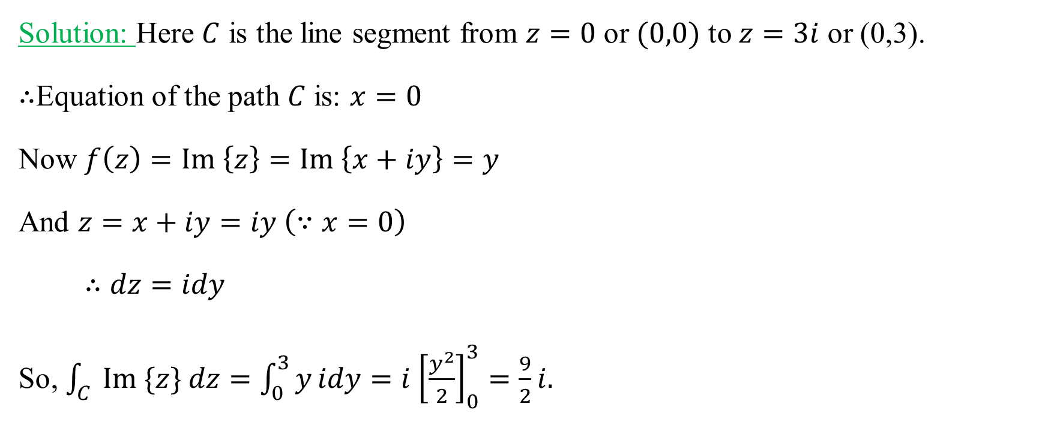
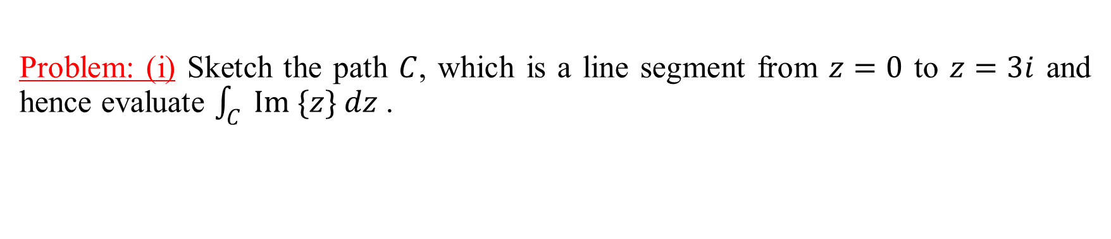


Problem: (i) Sketch the path $C$, which is a line segment from $z=0$ to $z=3i$ and hence evaluate $\int_{C}{ Im \{z\} dz}$ .
Solution: Here $C$ is the line segment from $z=0$ or $(0,0)$ to $z=3i$ or (0,3).
$∴$Equation of the path $C$ is: $x=0$
Now $f\left(z\right)=Im \left\{z\right\}=Im \left\{x+iy\right\}=y$
And $z=x+iy=iy \left(∵x=0\right)$
$∴dz=idy$
So, $\int_{C}{ Im \{z\} dz}=\int_{0}^{3}{y}idy=i$ ${\left[\frac{y^{2}}{2}\right]}_{0}^{3}=\frac{9}{2}i.$
Im {z}
$$(0, 3)$$
Re{z}
$$(0,0)$$
O

Slide 8
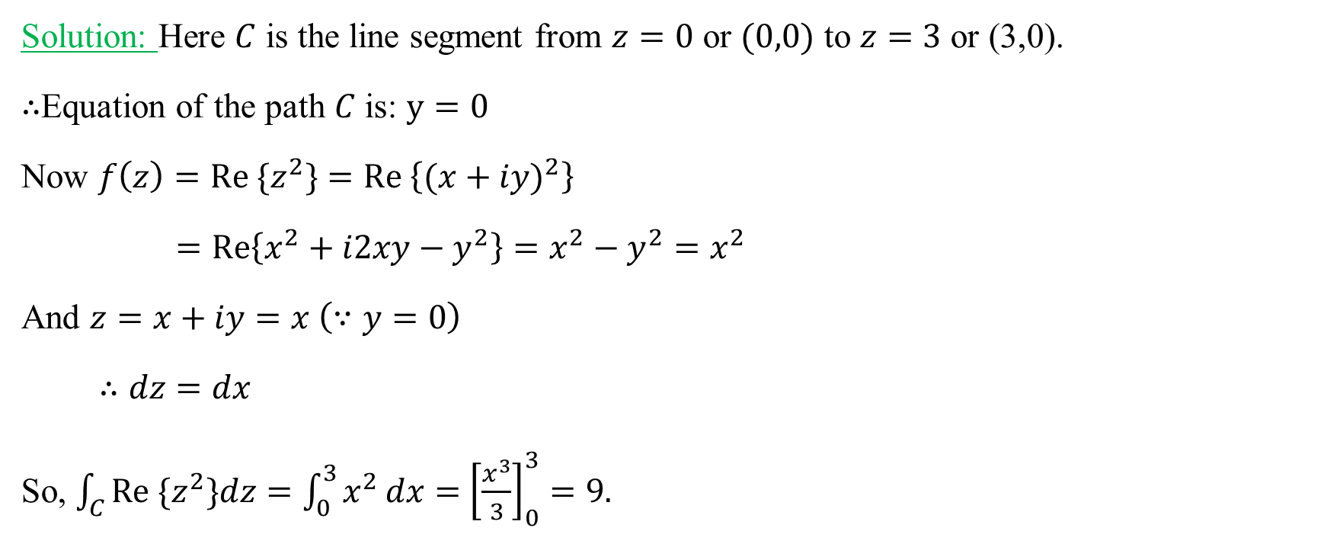
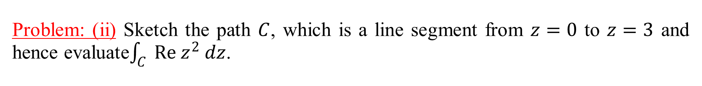

Problem: (ii) Sketch the path $C$, which is a line segment from $z=0$ to $z=3$ and hence evaluate$\int_{C}{ Re z^{2} dz}$.
Solution: Here $C$ is the line segment from $z=0$ or $(0,0)$ to $z=3$ or (3,0).
$∴$Equation of the path $C$ is: $y=0$
Now $f\left(z\right)=Re {\{z}^{2}\}=Re \left\{{(x+iy)}^{2}\right\}$
$=Re\left\{x^{2}+i2xy−y^{2}\right\}=x^{2}−$ $y^{2}=x^{2}$
And $z=x+iy=x \left(∵y=0\right)$
$∴dz=dx$
So, $\int_{C}{Re {\{z}^{2}\}dz}=\int_{0}^{3}{x^{2}}dx=$ ${\left[\frac{x^{3}}{3}\right]}_{0}^{3}=9.$
Im {z}
O
Re{z}
$$(0,0)$$
$$(3, 0)$$

Slide 9
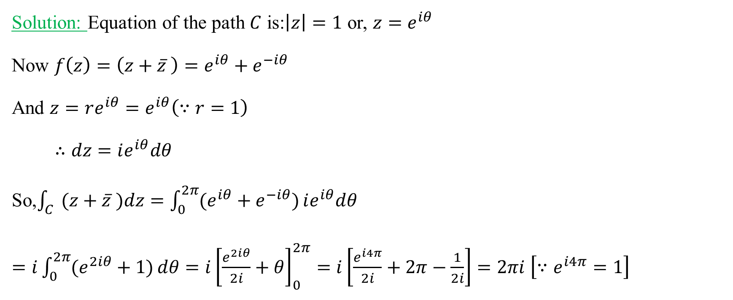
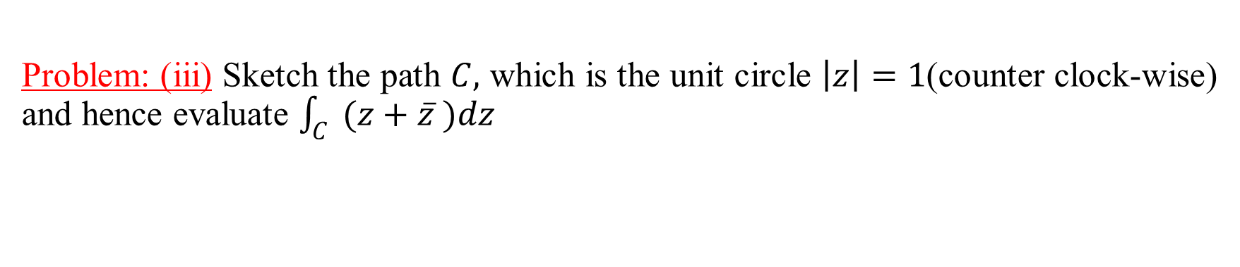

Problem: (iii) Sketch the path $C,$ which is the unit circle $\left|z\right|=1$(counter clock-wise) and hence evaluate $\int_{C}{ (z+\overline{z} )dz}$
Solution: Equation of the path $C$ is:$\left|z\right|=1$ or, $z=e^{iθ}$
Now $f\left(z\right)=\left(z+\overline{z} \right)=e^{iθ}+e^{−iθ}$
And $z=re^{iθ}=e^{iθ}\left(∵r=1\right)$
$∴dz=ie^{iθ}dθ$
So,$\int_{C}{ (z+\overline{z} )dz}=\int_{0}^{2π}{(e^{iθ}+e^{−iθ})}ie^{iθ}dθ$
$=i\int_{0}^{2π}{(e^{2iθ}+1)}dθ=i{\left[\frac{e^{2iθ}}{2i}+θ\right]}_{0}^{2π}=i\left[\frac{e^{i4π}}{2i}+2π−\frac{1}{2i}\right]=2πi$ $\left[∵e^{i4π}=1\right]$
Im {z}
O
$$1$$
Re{z}

Slide 10
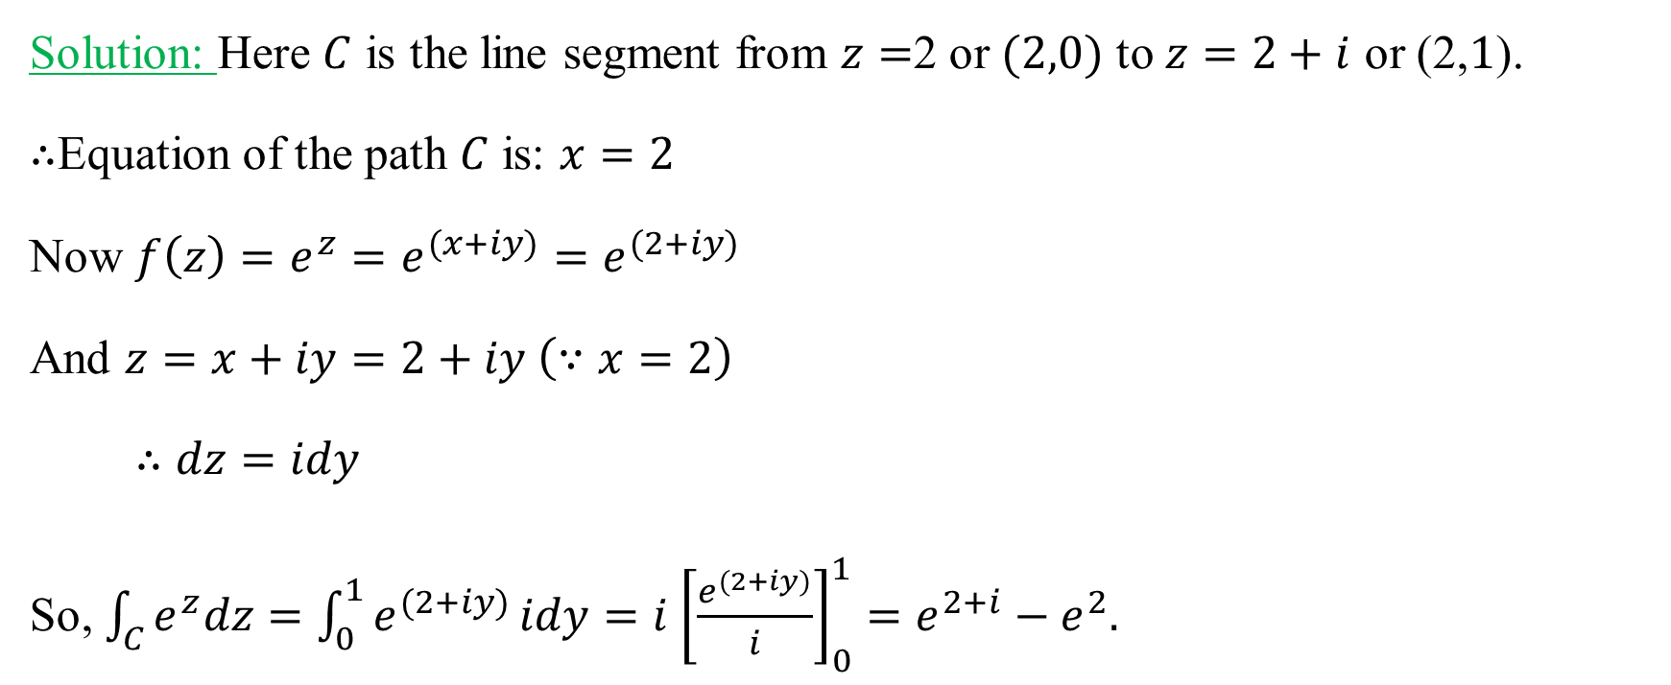
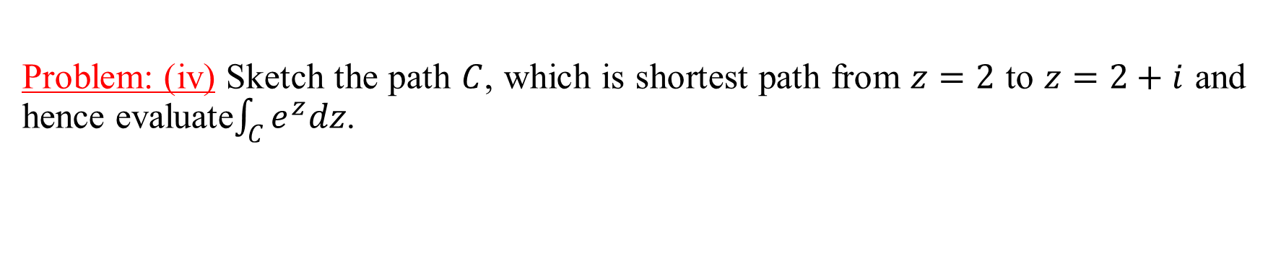


Problem: (iv) Sketch the path $C$, which is shortest path from $z=2$ to $z=2+i$ and hence evaluate$\int_{C}{e^{z}dz}$.
Solution: Here $C$ is the line segment from $z=$2 or $(2,0)$ to $z=2+i$ or (2,$1$).
$∴$Equation of the path $C$ is: $x=2$
Now $f\left(z\right)=e^{z}=e^{(x+iy)}=e^{(2+iy)}$
And $z=x+iy=2+iy \left(∵x=2\right)$
$∴dz=idy$
So, $\int_{C}{e^{z}dz}=\int_{0}^{1}{e^{(2+iy)}}idy=i$ ${\left[\frac{e^{(2+iy)}}{i}\right]}_{0}^{1}=e^{2+i}−e^{2}.$
Im {z}
$$(2, 1)$$
O
$$(2,0)$$
Re{z}

Slide 11
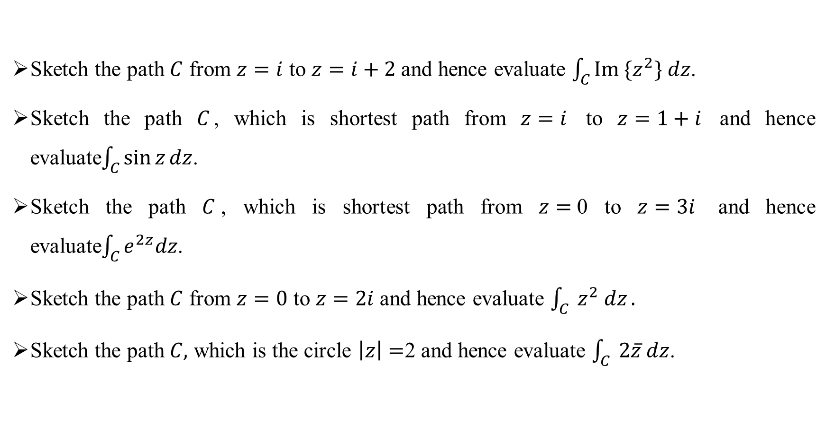
Exercises:
Sketch the path $C$ from $z=i$ to $z=i+2$ and hence evaluate $\int_{C}{{Im \{z}^{2}\} dz}$.
Sketch the path $C$, which is shortest path from $z=i$ to $z=1+i$ and hence evaluate$\int_{C}{\sin{z}dz}$.
Sketch the path $C$, which is shortest path from $z=$0 to $z=3i$ and hence evaluate$\int_{C}{e^{2z}dz}$.
Sketch the path $C$ from $z=0$ to $z=2i$ and hence evaluate $\int_{C}{ z^{2} dz}.$
Sketch the path $C,$ which is the circle $\left|z\right|=$2 and hence evaluate $\int_{C}{ 2\overline{z} dz}$.

Slide 12
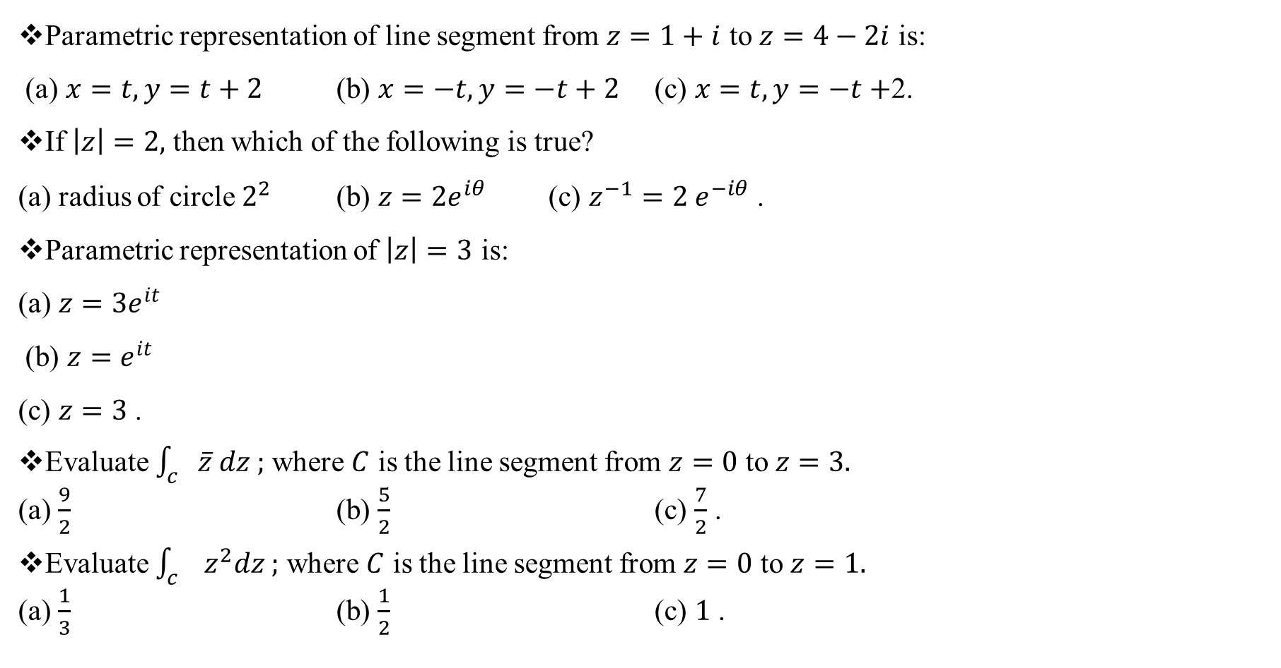
Sample MCQ:
Parametric representation of line segment from $z=1+i$ to $z=4−2i$ is:
(a) $x=t, y=t+2$ (b) $x=−t, y=−t+2$ (c) $x=t, y=−t+$2.
If $\left|z\right|=2,$ then which of the following is true?
(a) radius of circle $2^{2}$ (b) $z=2e^{iθ}$ (c) $z^{−1}=2 e^{−iθ}$ .
Parametric representation of $\left|z\right|=3$ is:
(a) $z=3e^{it}$
(b) $z=e^{it}$
(c) $z=3$ .
Evaluate $\int_{c}{\overline{z} dz ;}$ where $C$ is the line segment from $z=0$ to $z=3.$
(a) $\frac{9}{2}$ (b) $\frac{5}{2}$ (c) $\frac{7}{2}$ .
Evaluate $\int_{c}{ z^{2}dz ;}$ where $C$ is the line segment from $z=0$ to $z=1.$
(a) $\frac{1}{3}$ (b) $\frac{1}{2}$ (c) $1$ .

